Slide 1

Generative AI Toolkit for Developers, Product Owners & UI/UX Teams
Empowering innovation through intelligent automation and next-generation development capabilities

Slide 2




STRATEGIC INVESTMENT
Our Strategic AI Investment: VertexAI & Claude Code
Powering Innovation
We've made a significant commitment to generative AI by investing in Google's VertexAI platform and Anthropic's Claude Code assistant. This dual-platform approach gives our teams the flexibility and power to tackle diverse development challenges.
Ideation & Generation
Accelerated Engineering
Create innovative UI designs and code from natural language descriptions
Generate code blocks that meet specific requirements through advanced prompting
Team Empowerment
Equip developers, product owners, and designers with cutting-edge AI capabilities
This investment represents our commitment to staying at the forefront of software development, enabling our teams to work smarter, faster, and more creatively than ever before.

Slide 3
STRATEGIC INVESTMENT
Why This Matters:
Transforming How We Build Software
The integration of generative AI into our development workflow represents a fundamental shift in how we create software. This transformation extends beyond individual productivity gains to reshape our entire approach to building, testing, and deploying solutions.
🚀 Accelerated Cycles
🤝 Team Empowerment
📈 Scalable Delivery
Dramatically reduce time from ideation to production by leveraging AI-assisted creativity and code generation
Democratize advanced development capabilities, making sophisticated tools accessible to all team members
Build a foundation for secure, intelligent, and repeatable software delivery at enterprise scale
By investing in AI tooling, comprehensive training, and robust validation pipelines, we're not just adopting new technology—we're fundamentally upgrading our capacity to innovate and deliver value to our customers.

Slide 4

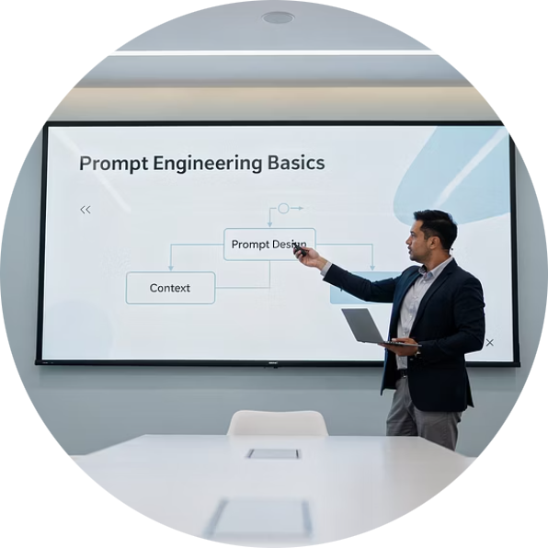
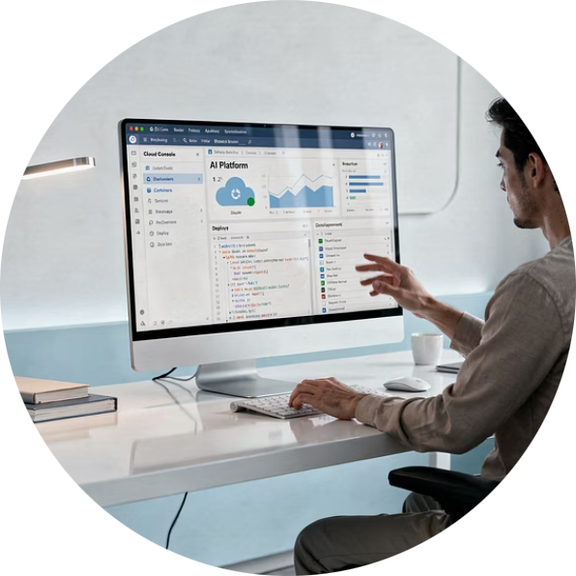
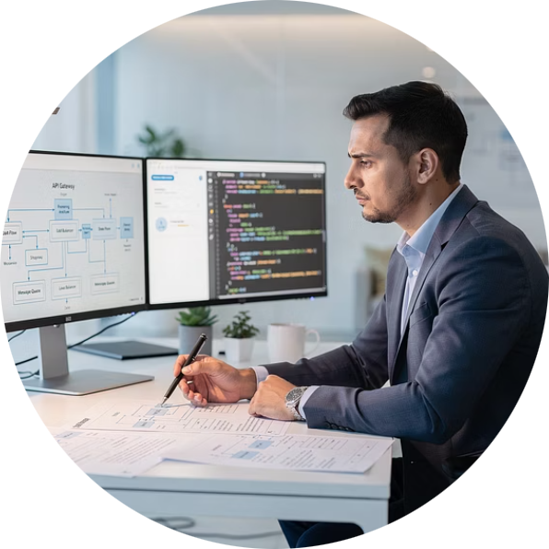
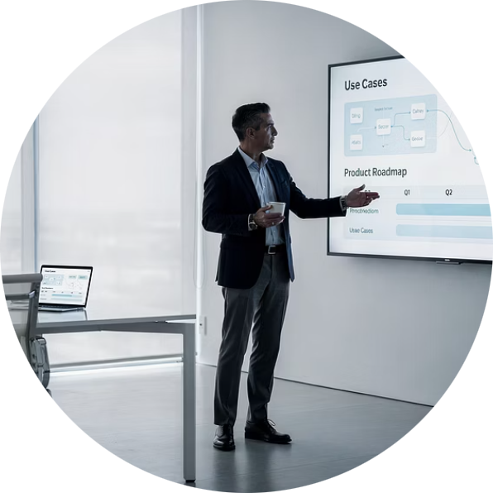
Topics Covered
Overview & Readiness:
Our technical leaders will guide you through hands-on demonstrations of prompt engineering techniques, development environments, and code generation processes. These sessions are designed to get you familiarized with our AI toolkit.
Ryan Colkitt
Sam Bushell
Mahesh Revuru
Trey Barnes
Prompt Engineering – Practical tips
VertexAI & Claude Environments
Architecture & Code Promotion
Ignite 2026 & Use Cases
Hands-on walkthrough of both platforms, including setup, configuration, best practices, and real-world usage scenarios. Get comfortable with the tools that will power your development.
Comprehensive overview of system architecture, code generation workflows, and promotion pipelines. Understand how AI-generated code moves from ideation to production deployment.
Walk through how business objectives translate into AI-driven development priorities. See how product vision, stakeholder alignment, and requirements definition and shape the uses cases from goal setting through delivery outcomes.
Live demonstration of proven techniques for crafting effective prompts that generate high-quality UI designs and code. Learn the patterns and strategies that produce the best results.

Slide 5
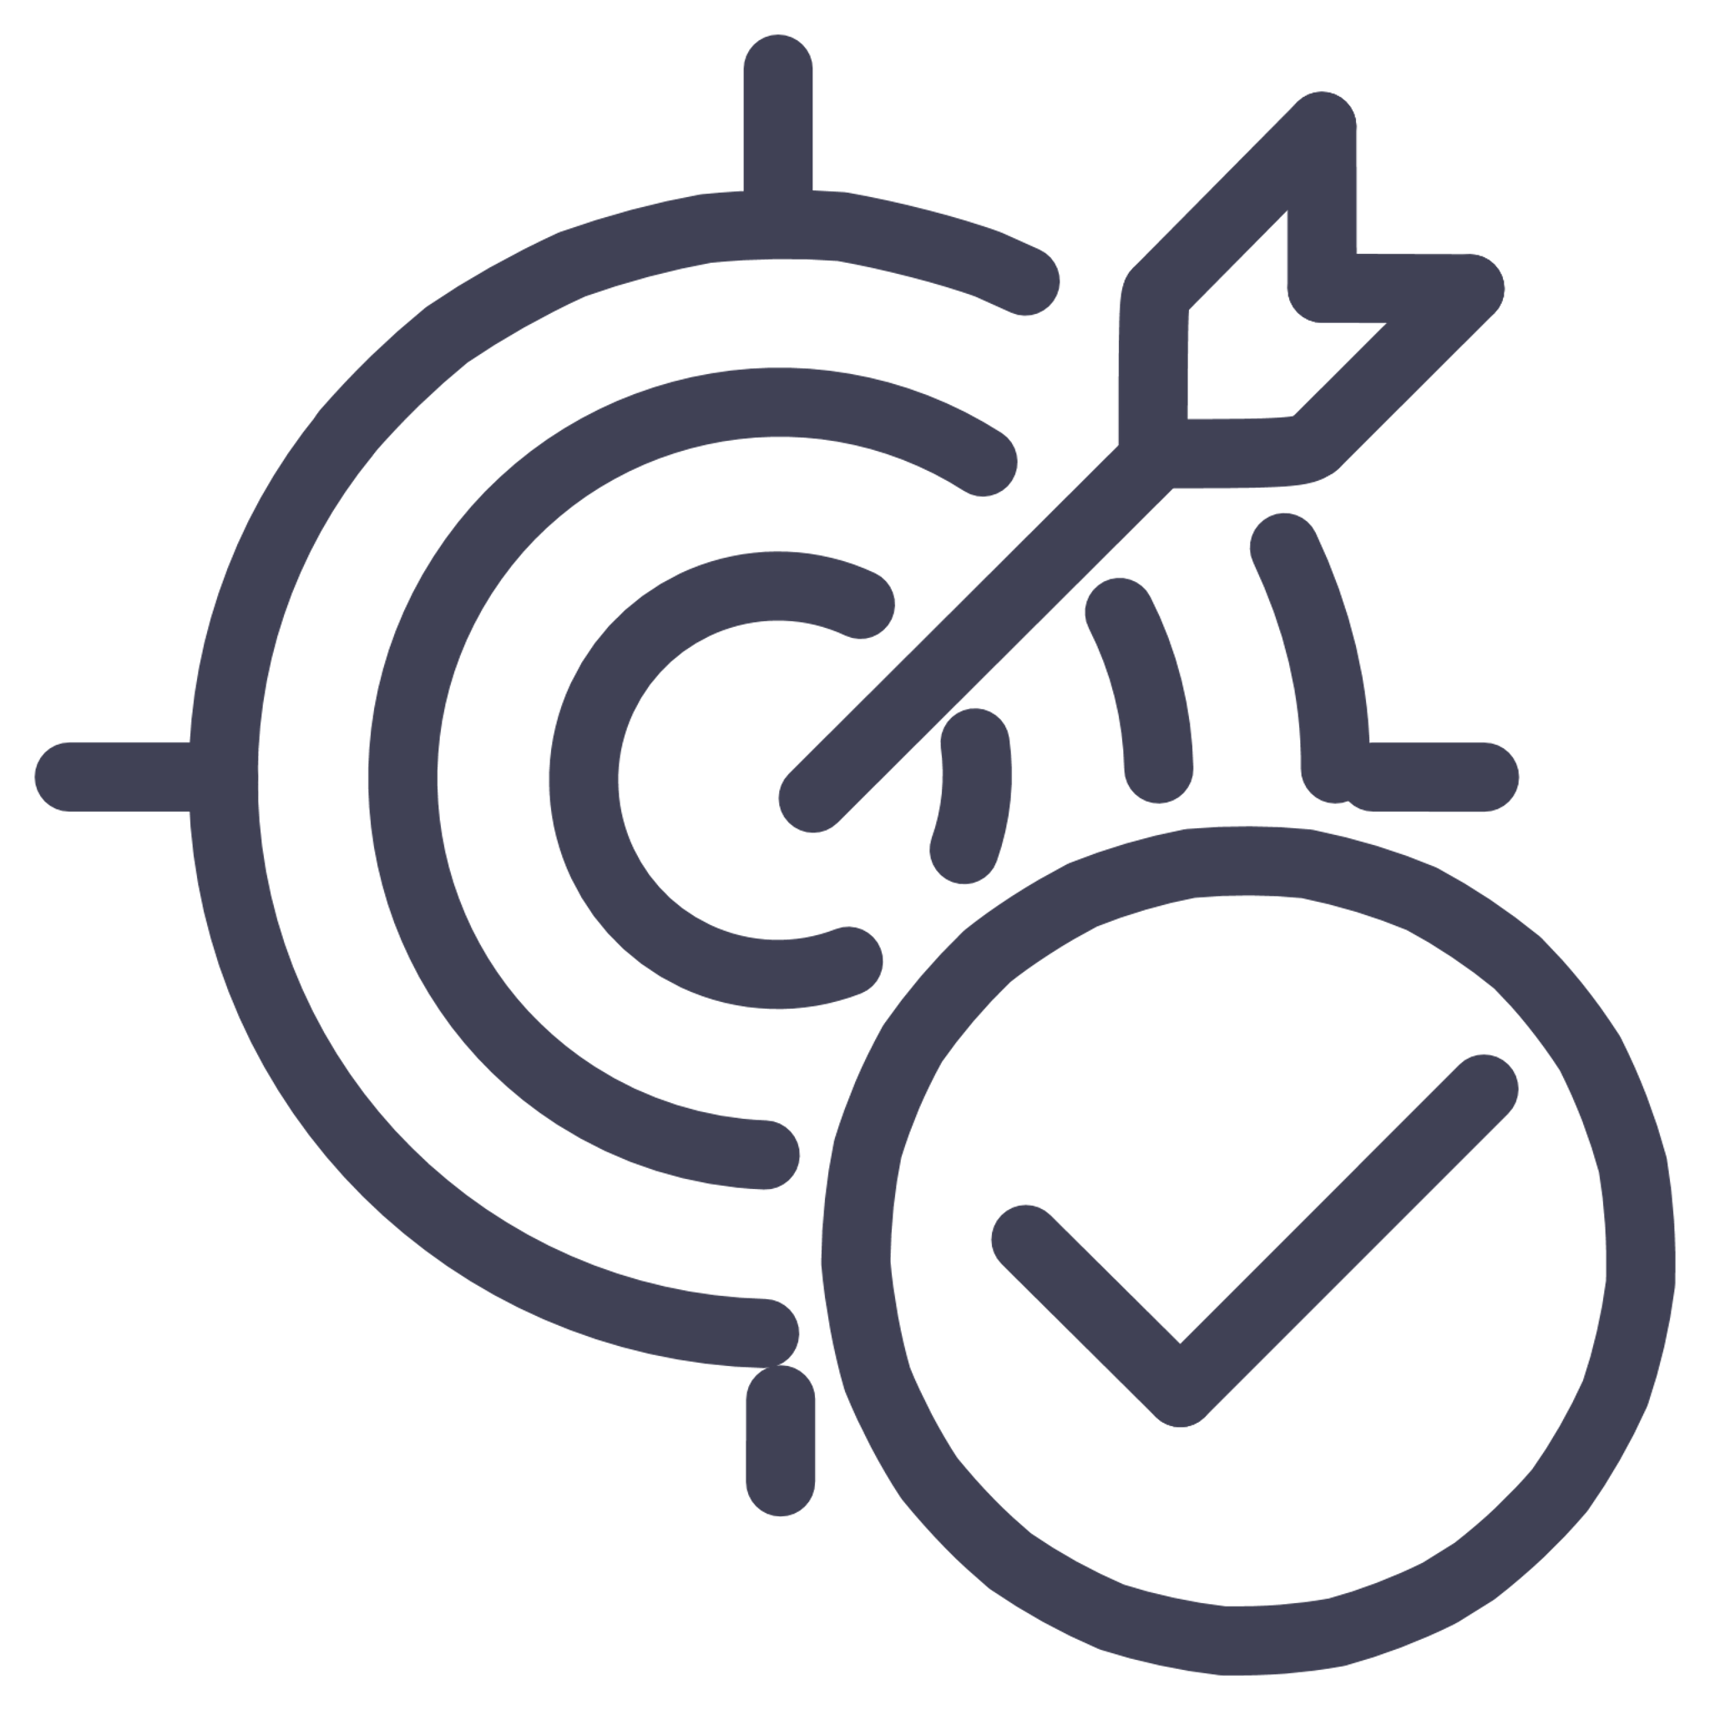
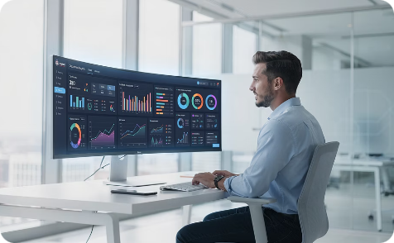
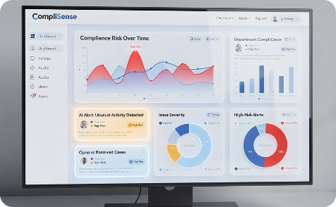
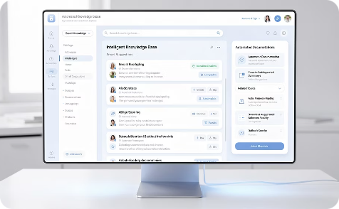
IGNITE 2026
Top AI Use Cases in Development for Ignite 2026
We're focusing development efforts on three transformative use cases that will revolutionize how we work with data, maintain compliance, and share knowledge. These initiatives represent our commitment to practical AI applications that deliver measurable business value.
DARA Insights with NLP-Based Query
Regulatory Change Control & Review
Process Evaluation & Determination (PMI Termination)
Revolutionary natural language processing system that allows users to ask questions in plain English and receive actionable data insights. No SQL knowledge required—just ask and discover.
Tracks regulatory and investor rule changes, triggers impact assessments, acceptance tests, and versioned updates. All rules managed in ADO with structured metadata and approval workflows.
Automates PMI eligibility checks and threshold calculations, evaluating investor rules and regulatory requirements in a single click. Every termination decision is logged, versioned, and fully explainable reducing manual review while ensuring consistency.

Slide 6
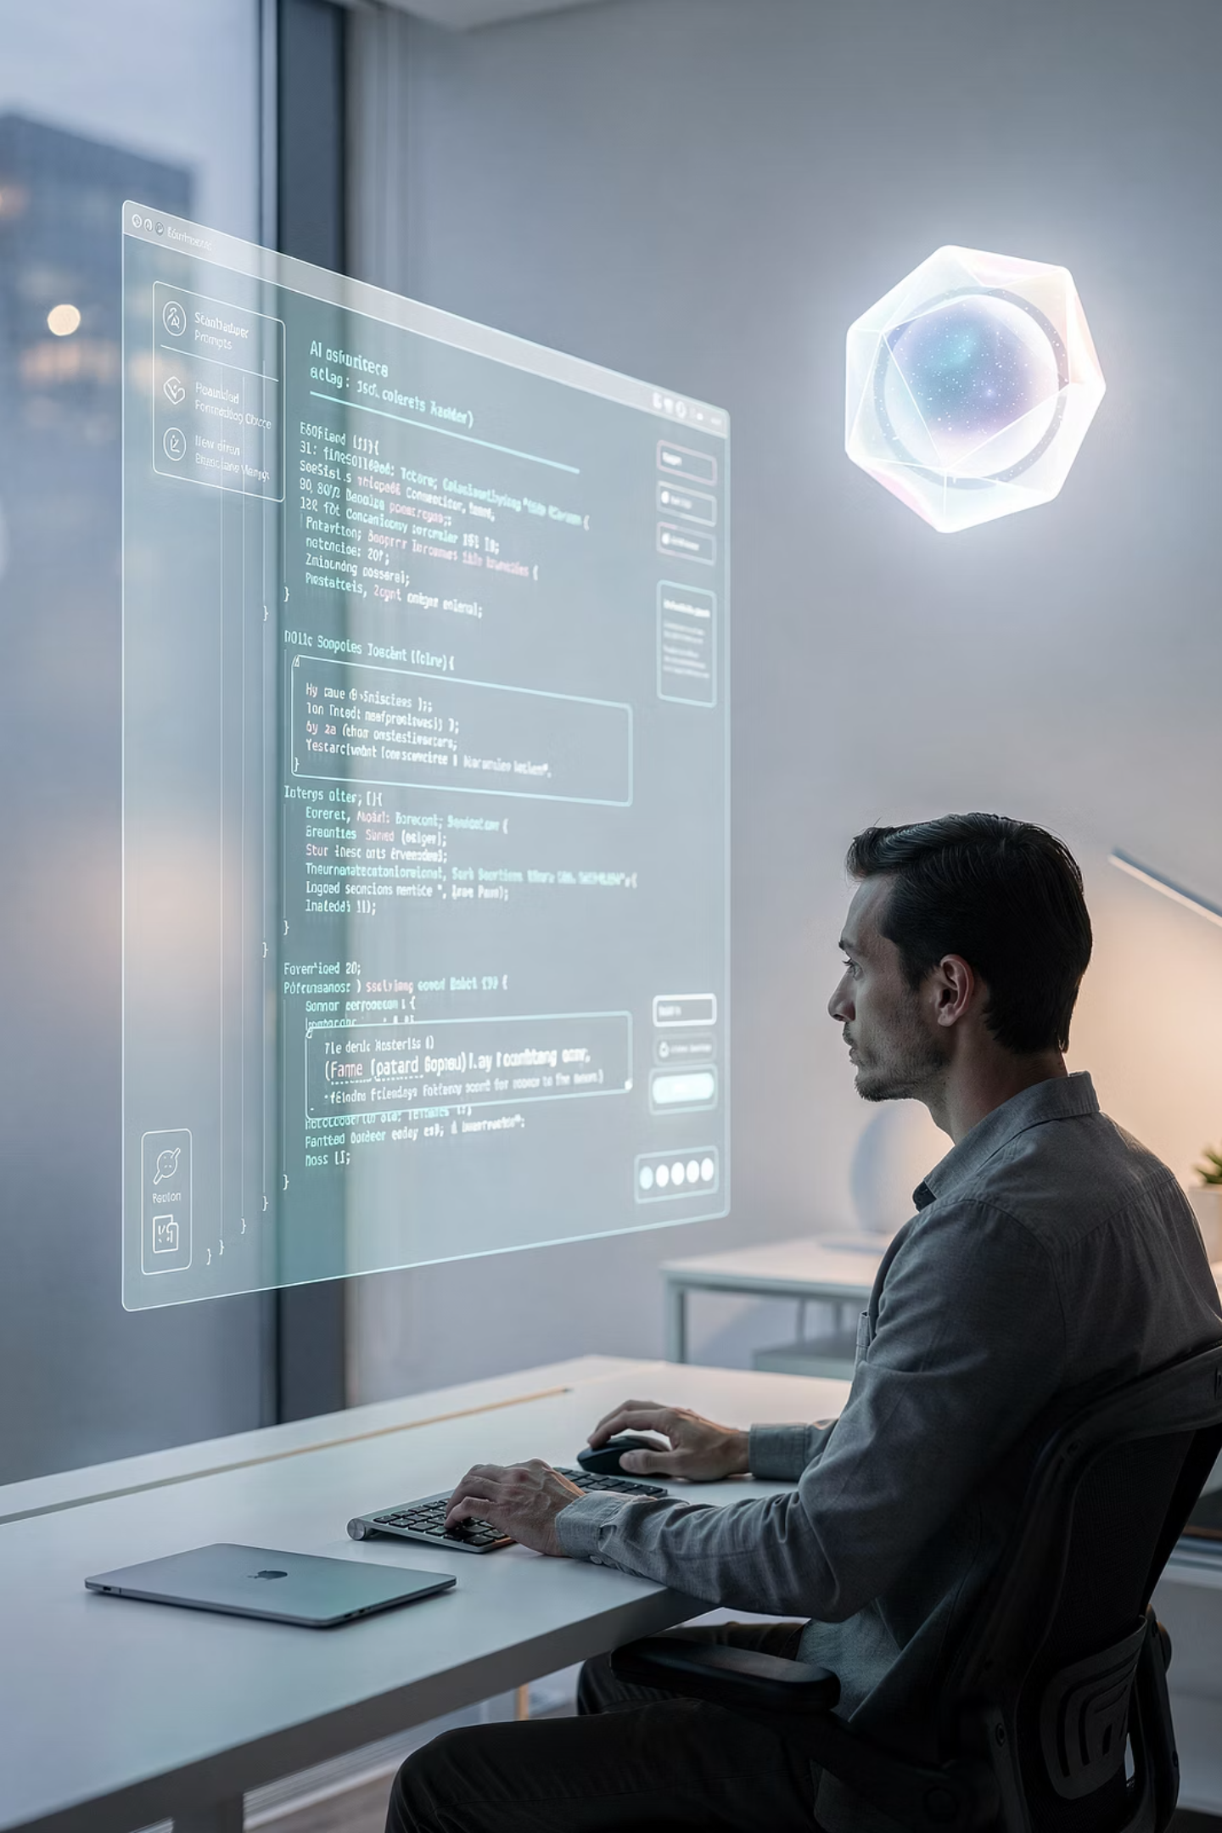

Hands-On Demo
Prompt Engineering:
The Key to AI-Driven UI & Code
The quality of AI-generated output is directly proportional to the quality of prompts provided. Effective prompt engineering is the cornerstone of successful AI-assisted development, transforming vague ideas into precise, production-ready solutions.
1
Clarity & Specificity
Define clear objectives with specific requirements, constraints, and desired outcomes
2
Context Enrichment
Provide relevant background, technical specifications, and business context
3
Iterative Refinement
Test, evaluate, and refine prompts to optimize AI performance and output quality
4
Full Potential
Unlock AI's capabilities for sophisticated UI designs and complex code generation
Mastering prompt engineering transforms AI from a simple tool into a powerful collaborative partner in the development process.

Slide 7
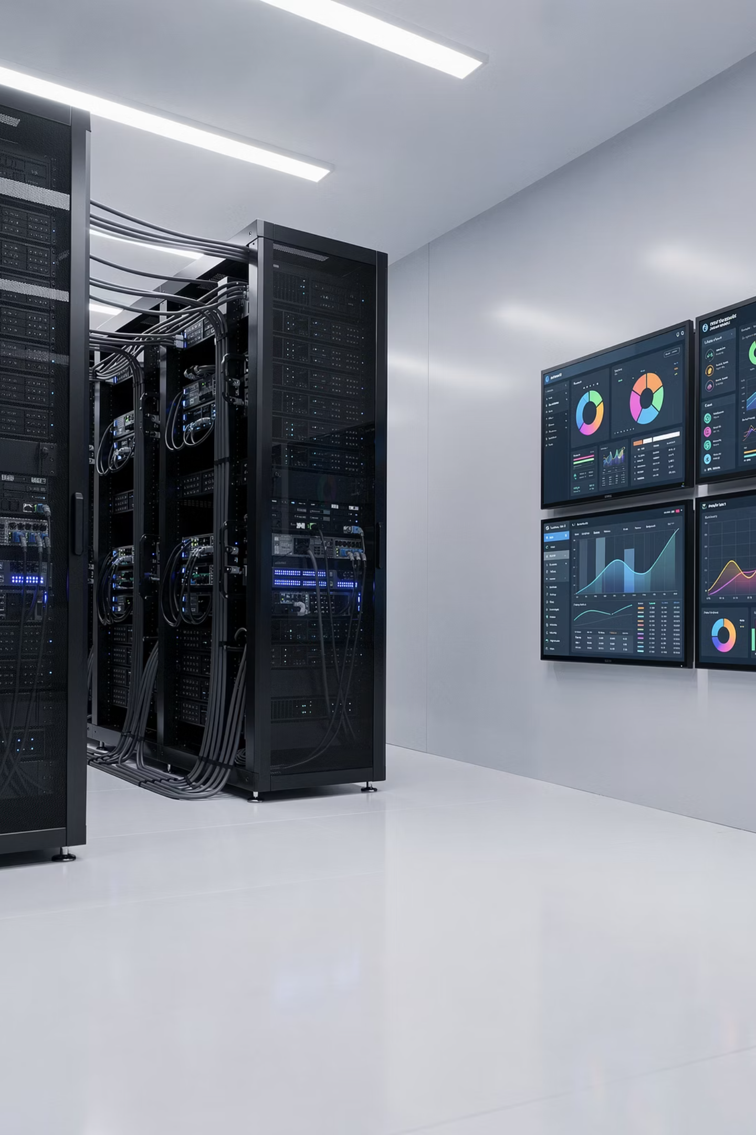

Development & Architecture
<In the works>
MCP Servers & Analytics Infrastructure
We're constructing a robust Model Context Protocol (MCP) server infrastructure that integrates seamlessly with our core data and development platforms. This foundation enables advanced analytics, streamlined workflows, and intelligent insights across all AI-generated assets.
1
2
3
MCP Server / Catalog Buildout
Data (OLAP)
Centralized Ideation Farm
Comprehensive integration with Snowflake for data warehousing, Storybook for component libraries, Google Cloud Storage for Docs (Knowledge Mgmt), and additional enterprise systems
Structured metadata layer enabling advanced analytics and business intelligence capabilities, making data accessible and actionable for AI-driven insights
Unified repository and visualization platform where all AI-generated ideas, designs, and code assets can be viewed, compared, and evaluated in one central location

Slide 8
Development & Architecture
<In the works>
Ensuring Quality & Security: “Dara-fy” Validation Pipeline
Before any AI-generated code reaches production, it must pass through our comprehensive Dara-fy validation pipeline. This automated quality gate ensures that all MVP-ready packages meet our stringent standards for code quality, security, and compliance.
Standards Compliance
Automated scanning for Dara coding standards, architectural patterns, and best practices
The validation process examines multiple dimensions of code quality, from adherence to organizational coding standards to security vulnerability scanning. This systematic approach protects our production environment while maintaining development velocity.
Security Protocols
Comprehensive security checks including vulnerability scanning and threat detection
Package Vetting
Review and approval of external dependencies, libraries, and third-party integrations
Quality Testing
Automated test execution ensuring code reliability, performance, and maintainability

Slide 9




<In the works>
Promotion-Ready Repositories & Governance Rules
Our promotion framework provides clear pathways for AI-generated code and UI assets to move from experimental prototypes to production-ready implementations. Well-defined governance rules ensure quality, security, and collaboration throughout the journey.
Streamlined Workflows
Governance Rules
Production Deployment
Optimized promotion processes designed specifically for AI-generated assets
Clear standards for version control, code review, testing, and release readiness
Smooth handoff ensuring AI innovations reach users quickly and safely
Our governance framework balances innovation speed with production stability, allowing teams to experiment boldly while maintaining enterprise-grade reliability.

Slide 10
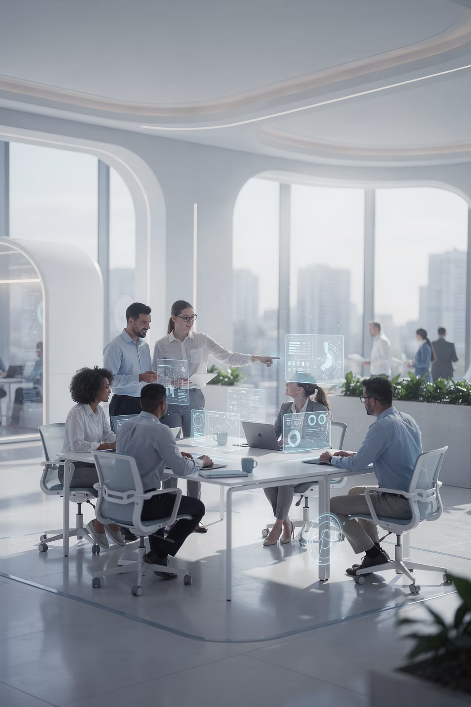
AI-Driven Journey
The future of software development is here, and it's powered by the collaboration between human creativity and artificial intelligence. We invite you to be part of this transformation.
Explore, Enable & Empower
Dive into our AI toolkit today. Attend the expert demonstrations, try the platforms, and discover what's possible with VertexAI and Claude Code.
Collaborate Across Teams
Break down silos between developers, product owners, and designers. The best innovations emerge when diverse perspectives combine with powerful AI capabilities.
Build the DARA Future Together
Let's harness generative AI to create software that's more innovative, more reliable, and more impactful than ever before. The journey starts now.

